Slide 1
Happy Well-being Wednesday!

Slide 2
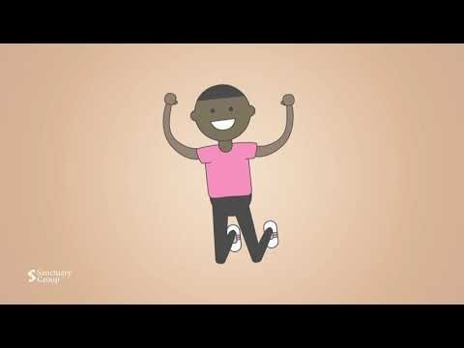
Happy Well-being Wednesday!

Slide 3
Happy Well-being Wednesday!
- How can you improve your 5 ways to Well-being?
- How are you going with your new focus from the first week back?
- Do you need to decide on a new focus to help with your well-being?

Slide 4
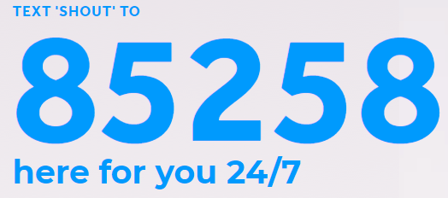
Useful helplines
https://www.thecalmzone.net/
https://www.childline.org.uk/
https://giveusashout.org/
https://www.papyrus-uk.org/
https://www.samaritans.org/?nation=scotland
https://www.anxietyuk.org.uk/
A useful website to use
https://www.nhs.uk/every-mind-matters/urgent-support/

Slide 5
Happy Well-being Wednesday!
Where to get help if you need support in school:
@RPCC there is so much support.
Tutors
Head of year support
Heads of year
Teachers
Support staff
Mental Health support workers
School Councillor
SLT
Well-being Champions
Mental health Ambassadors
Safe space stickers
Library with a range of resources
Anti-bullying ambassadors
Peer mentoring program

